Slide 1



Topographic Differencing
Chelsea Scott¹, Matt Beckley², Christopher Crosby², Viswanath Nandigam³, Ramon Arrowsmith¹, Minh Phan³
¹Arizona State University, ²UNAVCO, ³San Diego Supercomputer Center

Slide 2
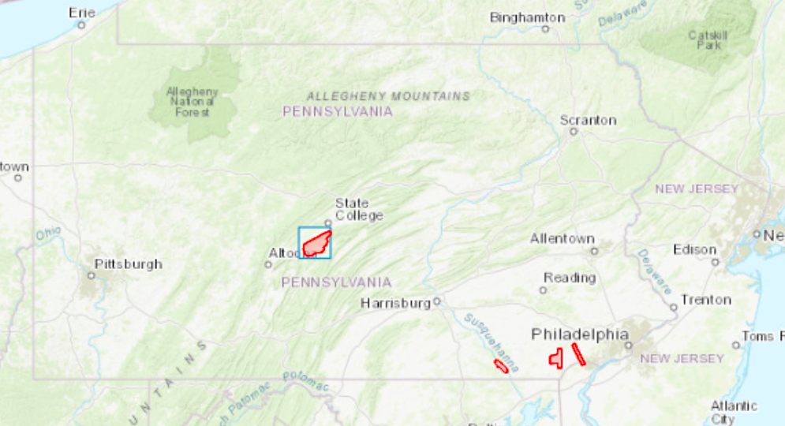
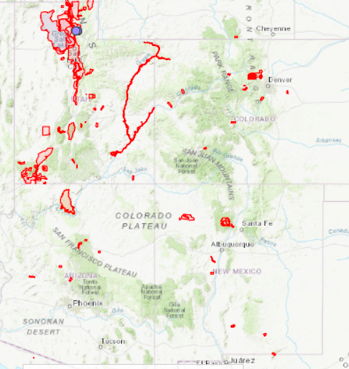
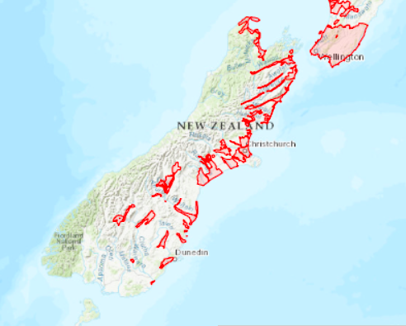
Process your own dataset:
Suggestions: Utah, New Mexico, Pennsylvania, New Zealand
Differecing button

Slide 3
Introduction
High resolution topography is a powerful observational tool for studying the Earth's surface and natural hazards.
When areas are imaged two or more times, multi-temporal topographic differencing detects surface change.
We have added the capability to perform on-demand topographic differencing for datasets in the OpenTopography archive.

Slide 4
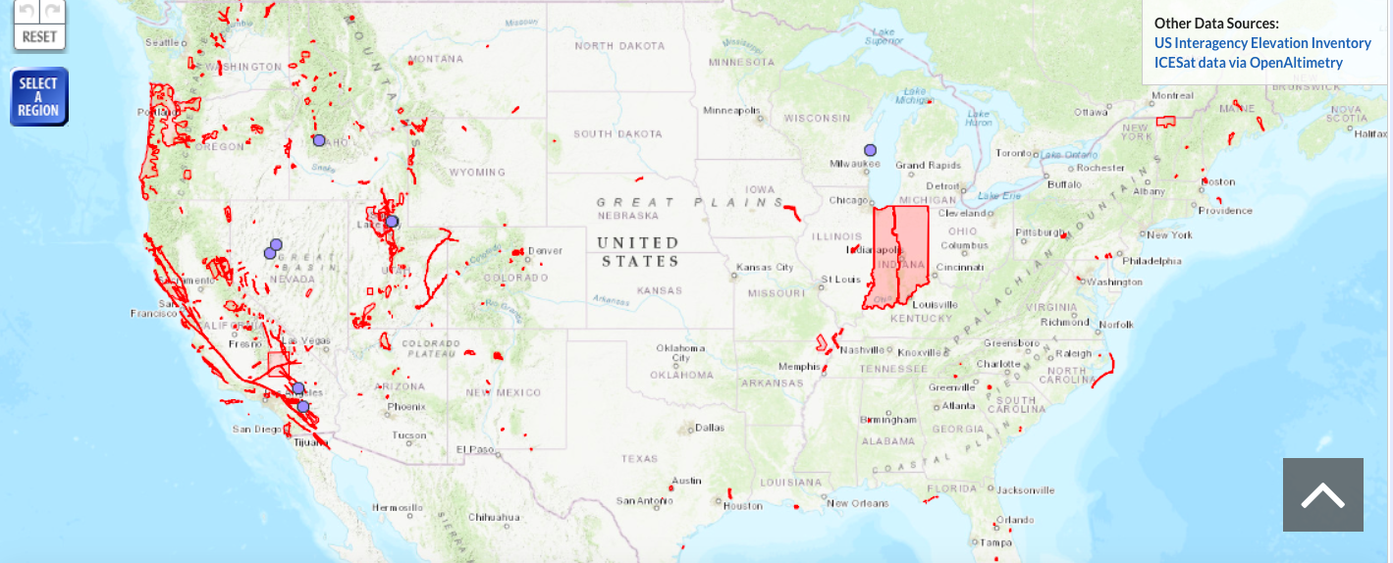
Open Topography & Topographic Differencing
Democratize online access to Earth science-oriented high-resolution topography
Data volume: 289 datasets, 244,000 km², 1.3 trillion pts
Next Generation Science: Multi-temporal differencing
Applications: Natural hazards, urban development, forest structure, river erosion

Slide 5
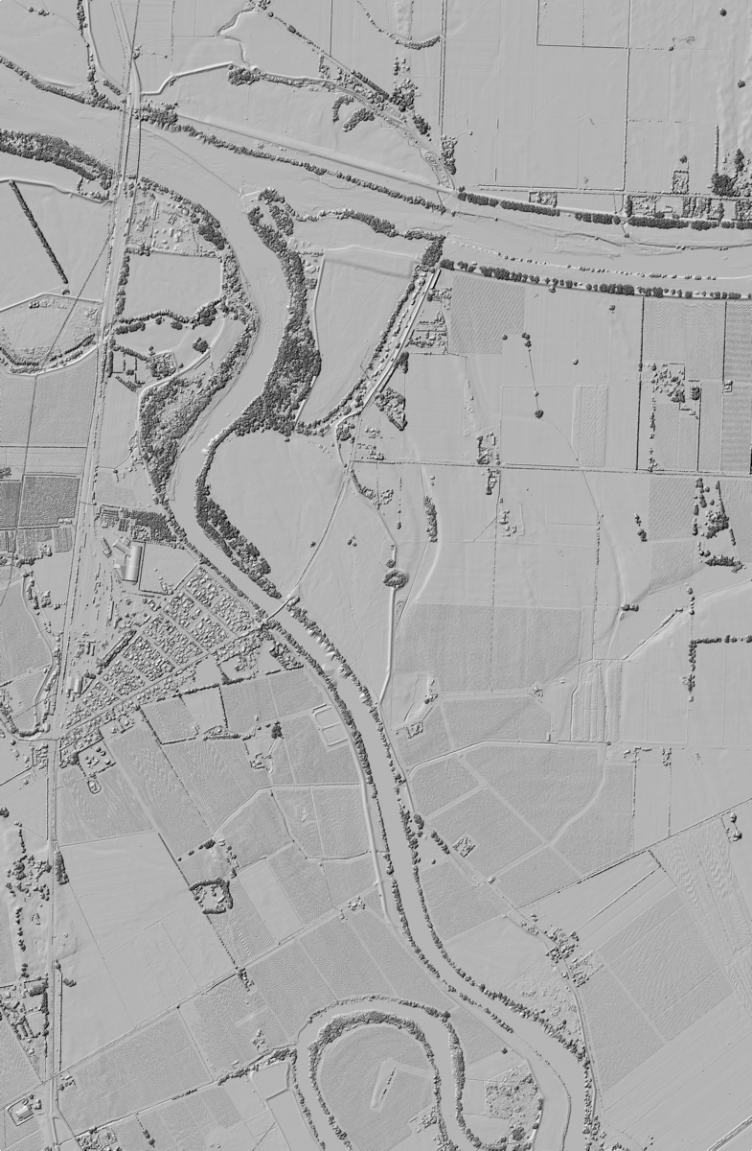
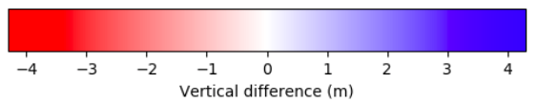
Topographic differencing
Vertical differencing (1D)
Image Correlation (2D)
Iterative Closest Point (3D)
South Island, New Zealand
-4
0
4
Vertical Difference (m)

Slide 6
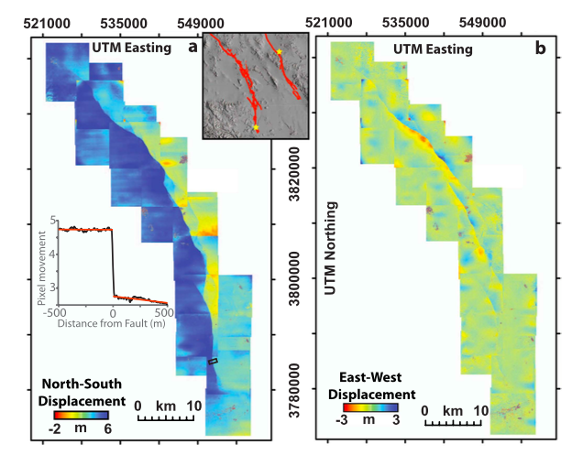
Topographic differencing
Vertical differencing (1D)
Image Correlation (2D)
Iterative Closest Point (3D)
Optical correlation displacements for the 1992 Landers Earthquake (Milliner et al., 2015)

Slide 7
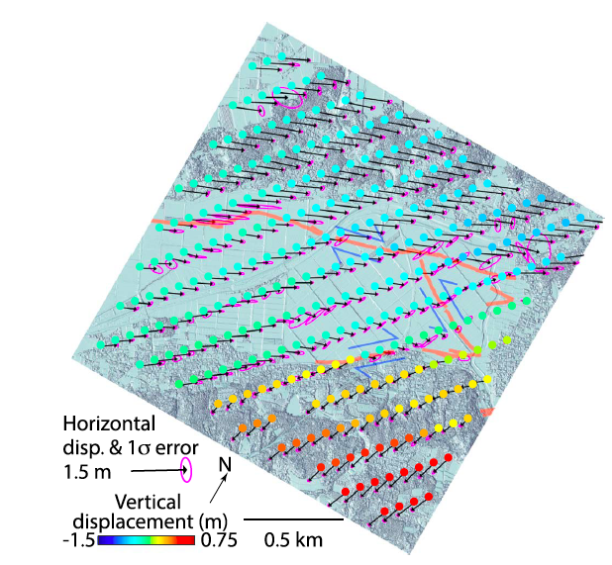
Topographic differencing
Vertical differencing (1D)
Image Correlation (2D)
Iterative Closest Point (3D)
3D displacements for the M7 2016 Kumamoto, Japan, Earthquake (Scott et al., 2018)
  Besl and McKay (1992); Geiger et al., (2012); Nissen et al., (2012; 2014)

Slide 8
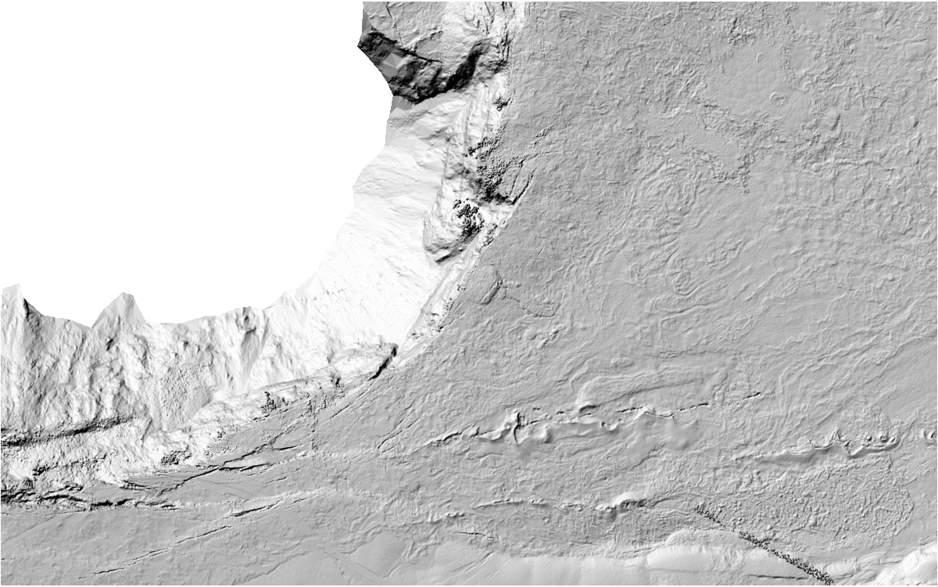
Challenges & Requirements
Legacy datasets
  Become invaluable following event
  Metadata quality control
Hybrid data
  Current: point cloud and raster data, varying shot density
  Future: TLS, SfM, global raster data
Algorithms
  On-demand with different data types
Cyber-infrastructure
  Must interact with current HPC system
2018 Kilauea Eruption

Slide 9
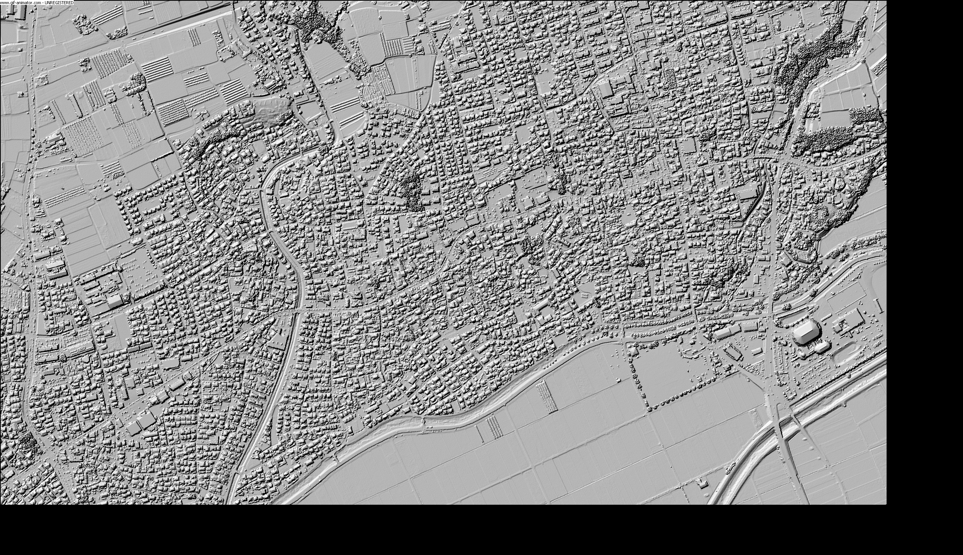
Vertical differencing
Overlapping data
Dataset must be on identical grids
  Original raster and gridded point cloud data
  Varying raster and shot densities
Raster subtraction
Option to remove points below a user-defined error threshold
Display difference maps and histogram of differences
Infrastructure damage following the 2016 M7 Kumamoto, Japan, earthquake.

Slide 10
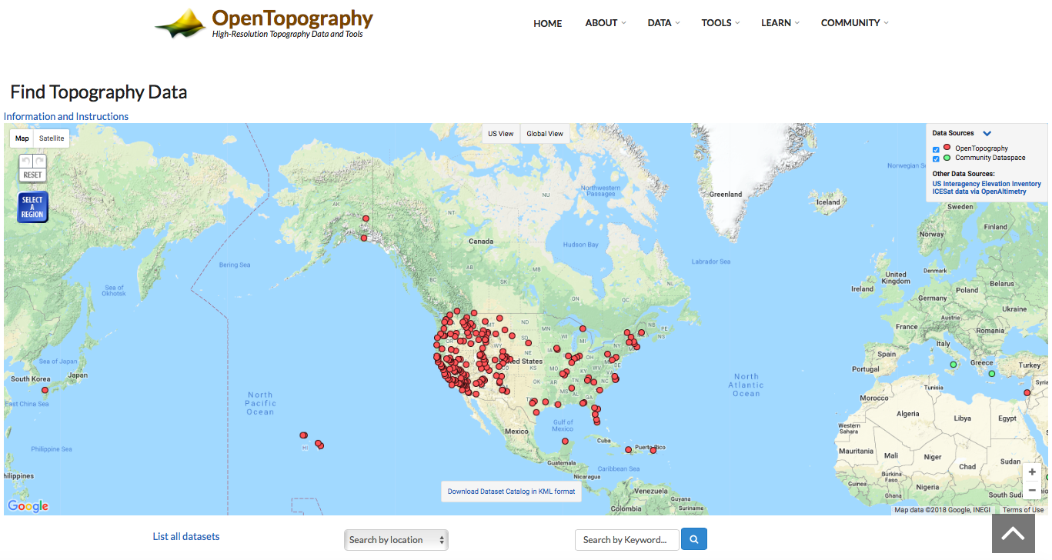
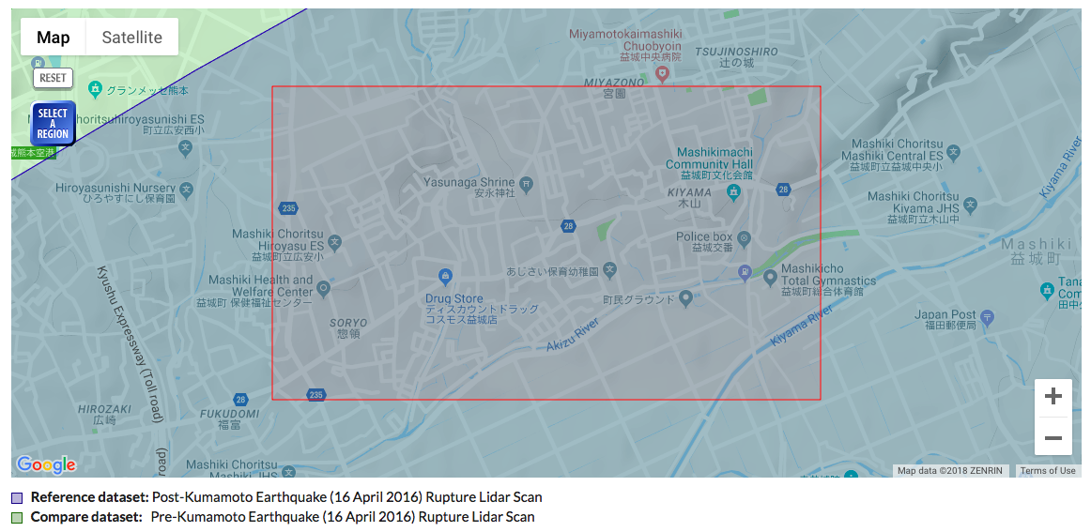
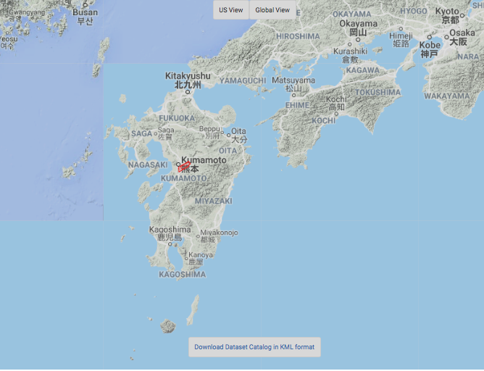

Slide 11
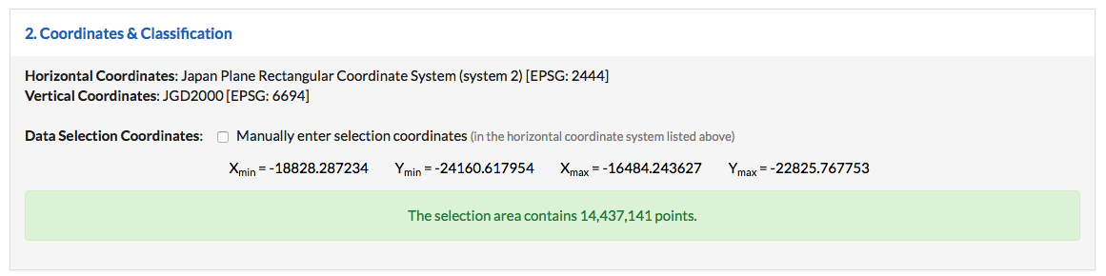
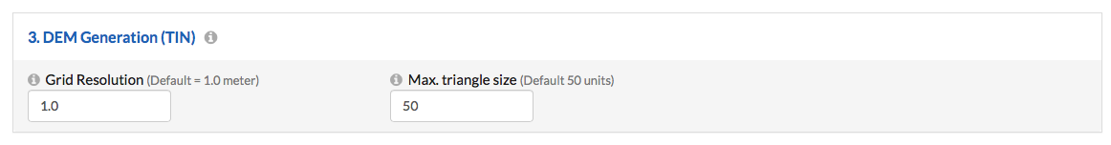
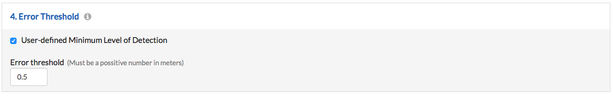
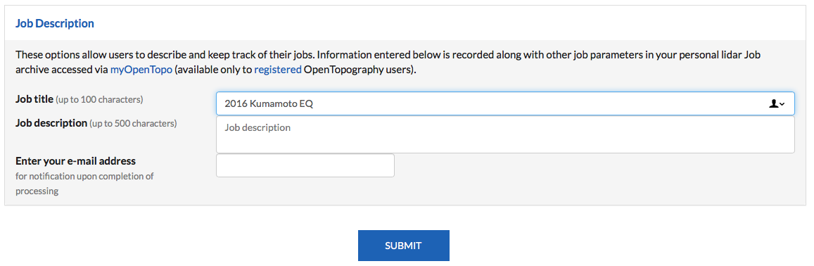
Select area to process
Grid resolution
User-defined level of detection

Slide 12
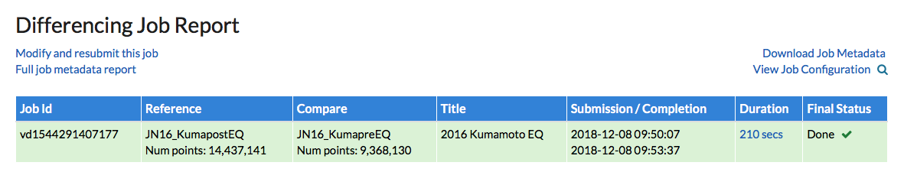
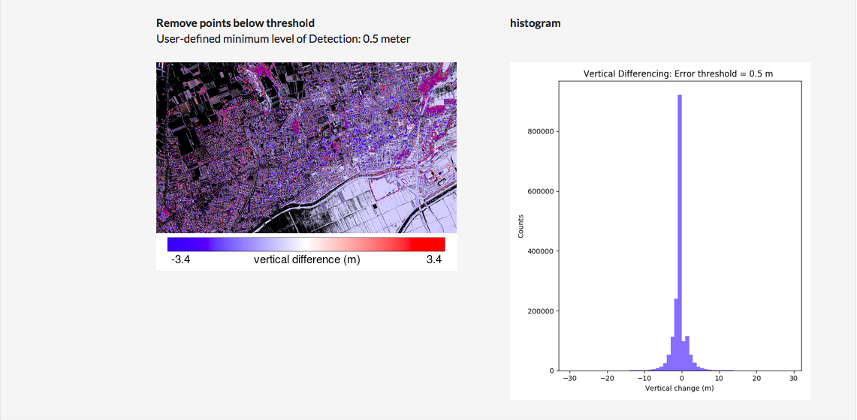
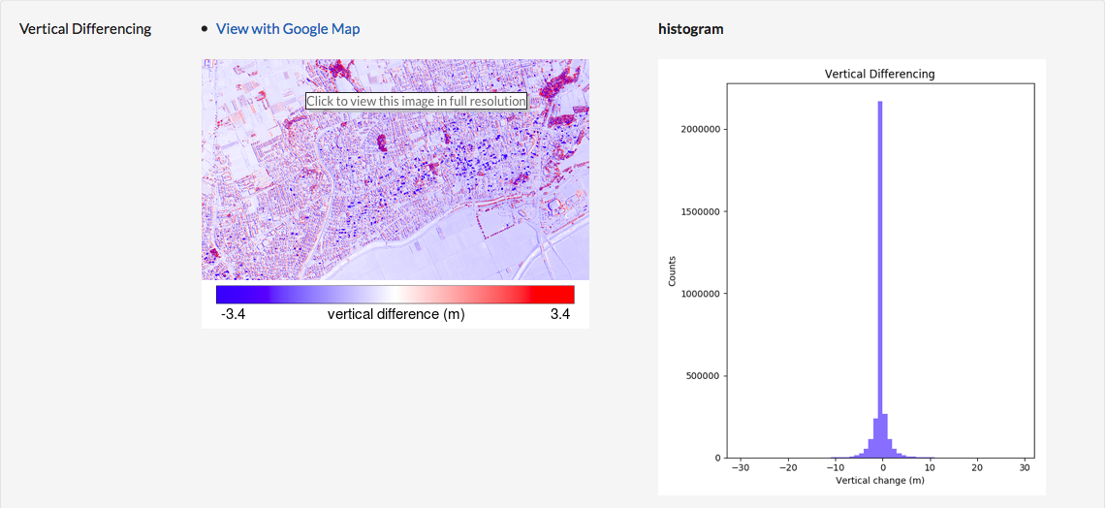

Slide 13
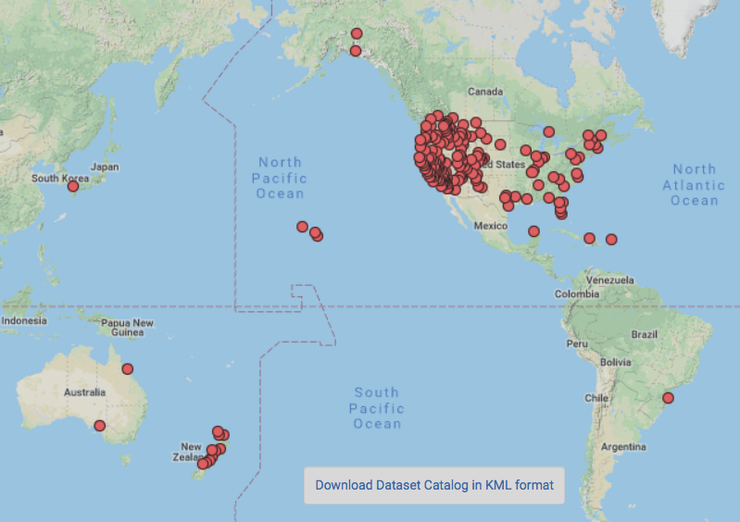
Where can I perform differencing?
  Currently, 40 dataset pairs
  Salt Lake City, Utah
  Critical Zone Observatory
  Rivers and riparian zones
  Natural hazards
    Slumgullion Landslide, CO
    Rock Falls, Yosemite, CA
    2018 Kilauea eruption, HI
    2010 M7.2 El Mayor Cucapah, MX
    2016 M7 Kumamoto, Japan
  More to come!

Slide 14
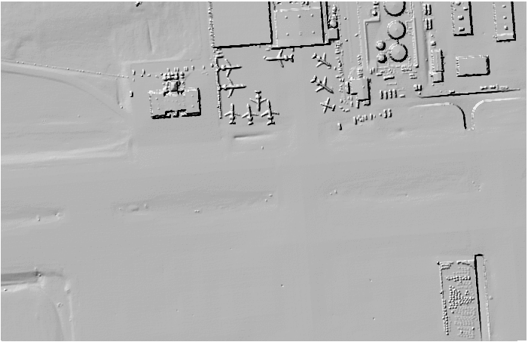
Salt Lake City Airport
Differencing: 2011-2013
-15
0
15
Vertical Difference (m)

Slide 15
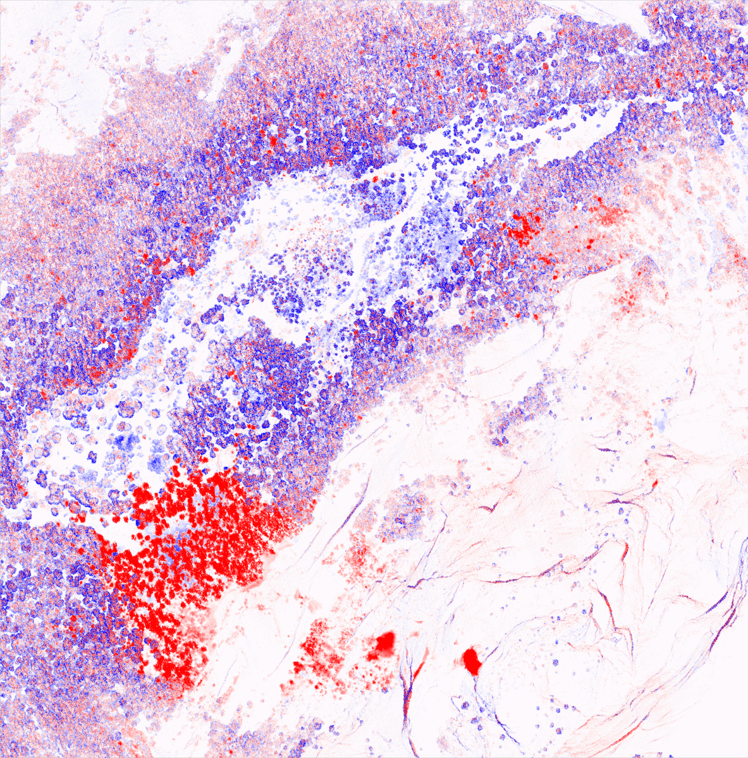
Yosemite, CA
Differencing: 2011-2013
-15
0
15
Vertical Difference (m)

Slide 16
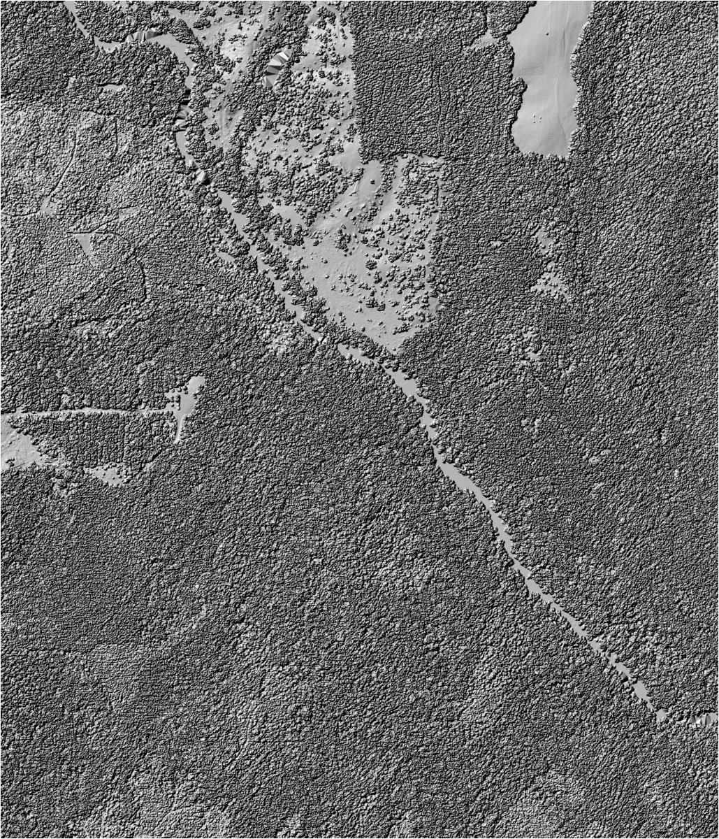
Calhoun, South Carolina
Critical Zone observatory
How does land with extensive agricultural and water degradation recover?
Differencing: July 2014- February 2016
-15
0
15
Vertical Difference (m)

Slide 17
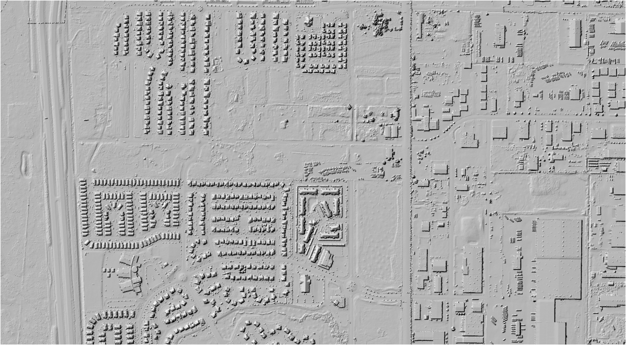
Salt Lake City, Utah
-4
0
4
Differencing: Oct 2015- Oct 2017
Vertical Difference (m)

Slide 18
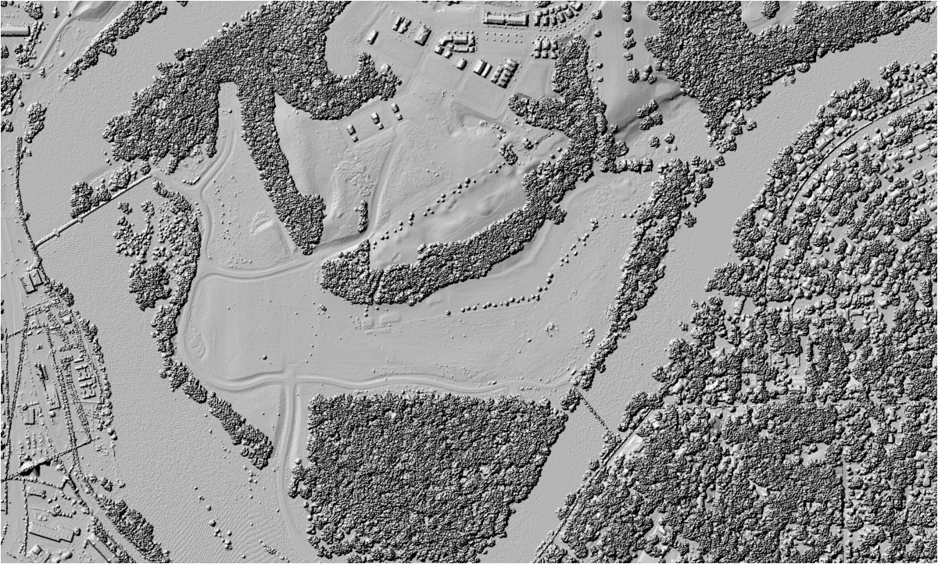
Iowa City, Iowa
-8
0
8
Differencing: June 2008- August 2014
Vertical Difference (m)

Slide 19
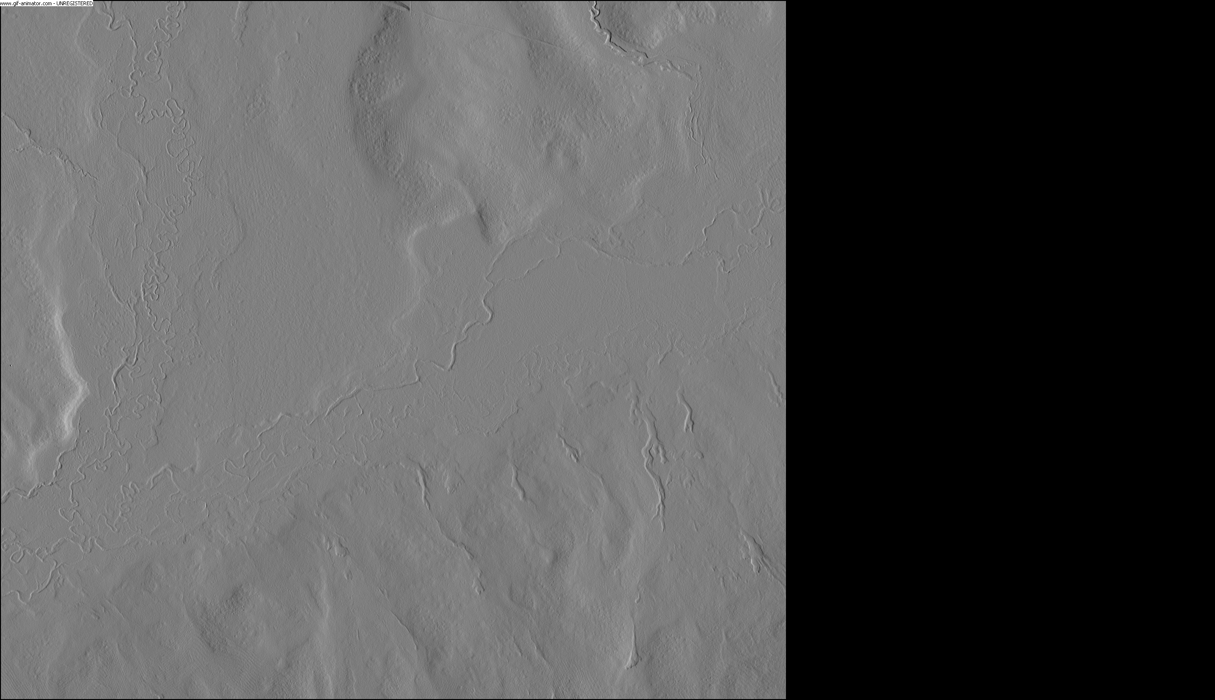
Conclusions
On-demand vertical differencing is implemented on OpenTopography.
Topographic change detection images landscape change from a variety of processes including natural hazards and urban growth.
Snow on and Snow-off in the Jemez River Basin, NM

